Slide 1
IBM University Engagement Project Submission
“Exploring the Power of Agentic AI with IBM Granite and LangFlow”

Slide 2

Project Title – GrantAI : Agentic AI Grant and Funding Finder for Startups
Domain of Project – Artificial Intelligence / Startup Ecosystem
Student Name | Recent Passport Photo | Email ID | Mobile number [WhatsApp]
Ayush Joshi |  | ayush.joshi2402@gmail.com | 7350131757

Slide 3
Problem Statement -
Problem Statement : AI Grant and Funding Finder for Startups
Problem Statement No. 18 – AI Grant and Funding Finder for Startups
The Challenge
Startups often struggle to discover relevant government grants and funding opportunities because information is distributed across multiple schemes, portals, guidelines, and unstructured documents.
Grant eligibility conditions, funding support, application requirements, and deadline information are often described in lengthy documents with different formats and terminology. Manually analysing these sources is time-consuming and may cause founders to overlook suitable opportunities.
Personalizing funding recommendations is another challenge because the relevance of a grant depends on factors such as the startup's sector, development stage, location, funding requirement, and project objectives.
Proposal preparation further requires founders to align their startup information with scheme-specific requirements without inventing unsupported claims.
The Objective
Build an AI-powered Grant and Funding Finder that:
• Recommends relevant government grant schemes based on startup context. • Retrieves grant information from an indexed knowledge base using RAG. • Assesses eligibility using available startup and grant evidence. • Generates grounded proposal drafts and proposal guidance. • Analyses deadline information without inventing unsupported dates. • Provides evidence-based notification and next-action guidance. • Coordinates specialized AI capabilities through a unified multi-agent workflow. • Preserves supporting source metadata for transparent AI responses.

Slide 4
Proposed Solution -
Proposed Solution: GrantAI – Agentic AI Grant and Funding Finder
GrantAI is an AI-powered grant discovery and funding assistance platform designed to help startups navigate government funding opportunities through grounded, context-aware AI.
The solution combines IBM Granite, IBM watsonx.ai, Retrieval-Augmented Generation (RAG), semantic retrieval, and a multi-agent workflow to transform fragmented grant information into actionable startup guidance.
At the core of GrantAI is a shared RAG pipeline. Government grant documents are processed, embedded, and indexed in a FAISS vector store. When a startup submits its profile or funding query, the system performs semantic retrieval to identify relevant grant evidence. The retrieved context is passed to IBM Granite through focused prompt builders to generate grounded responses.
GrantAI consists of five specialized AI capabilities:
Grant Recommendation Agent – Identifies relevant grant schemes based on startup sector, stage, location, and funding needs.
Eligibility Agent – Compares startup information with retrieved grant requirements and distinguishes confirmed, missing, and unsupported eligibility information.
Proposal Generation Agent – Creates a grant-focused proposal draft using supplied startup facts and retrieved scheme evidence.
Deadline Analysis Agent – Analyses application timing while preventing fabricated or unsupported deadlines.
Notification Agent – Generates evidence-based reminders and practical next actions without creating false urgency.
A WorkflowCoordinator coordinates these capabilities for multi-task founder requests and a UnifiedResponseBuilder combines their outputs into one structured grant journey.
The React frontend and FastAPI backend provide a user-friendly interface for grant discovery, eligibility analysis, proposal generation, deadline guidance, and AI-assisted workflows.
Overall, GrantAI acts as an intelligent funding guidance platform that helps startups move from grant discovery to application preparation using grounded AI.

Slide 5
Technology Used
• IBM Granite Models – Used for grounded natural language generation, reasoning, summarization, grant analysis, and proposal assistance.
• IBM watsonx.ai – Provides access to IBM Granite for AI inference and model-powered generation.
• IBM Cloud – IBM cloud ecosystem used to support the AI integration and project environment.
• Retrieval-Augmented Generation (RAG) – Retrieves relevant grant evidence before generation to improve grounding and reduce unsupported responses.
• FAISS Vector Database – Stores document embeddings and supports semantic similarity search across the government grant knowledge base.
• Embedding & Semantic Retrieval Pipeline – Converts grant content and user queries into vector representations for evidence retrieval.
• FastAPI – Provides REST API endpoints and backend application integration.
• React + TypeScript + Vite – Used to build the responsive GrantAI frontend.
• Prompt Engineering – Dedicated prompt builders enforce role definition, context separation, task focusing, evidence grounding, and non-fabrication safeguards.
• Multi-Agent Workflow Coordination – WorkflowCoordinator coordinates recommendation, eligibility, proposal, deadline, and notification capabilities.

Slide 6
Core Component Used -
1)React User Interface – Accepts startup profiles, grant queries, eligibility inputs, proposal context, deadline requests, and notification context.
2) FastAPI API Layer – Provides thin REST endpoints for recommendation, eligibility, proposal generation, deadline analysis, notifications, chat, and unified workflows.
3) Specialized AI Services – GrantRecommendationService, EligibilityService, ProposalGenerationService, DeadlineService, and NotificationService handle focused grant tasks.
4) WorkflowCoordinator – Coordinates multiple AI services sequentially for complete grant-journey requests.
5) Shared RAGAnswerService – Provides the common production path for retrieval, grounded prompt construction, and IBM Granite generation.
6) Semantic Retriever + FAISS – Retrieves the most relevant grant evidence from the indexed government grant corpus.
7) IBM Granite Model via watsonx.ai – Generates grounded recommendations, assessments, proposal content, deadline guidance, and action reminders.
8) Prompt Builders – Apply task-specific prompt engineering and non-fabrication safeguards.
9) UnifiedResponseBuilder – Combines multi-agent results into a structured response for the user.
10) Source Mapping Layer – Preserves available grant name, organization, source document, and page metadata.

Slide 7
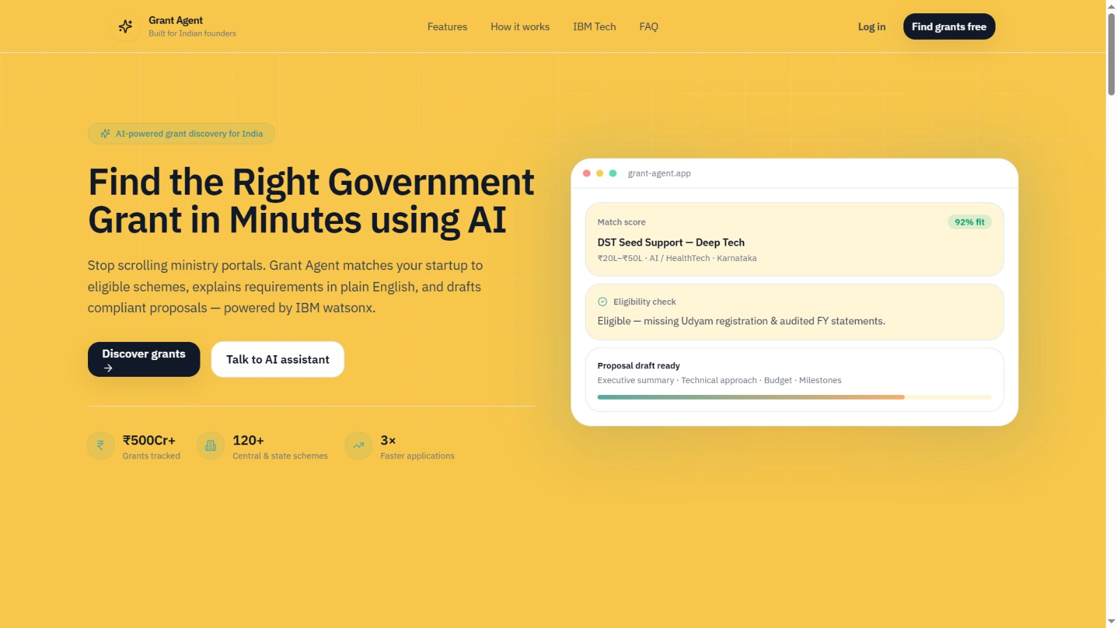
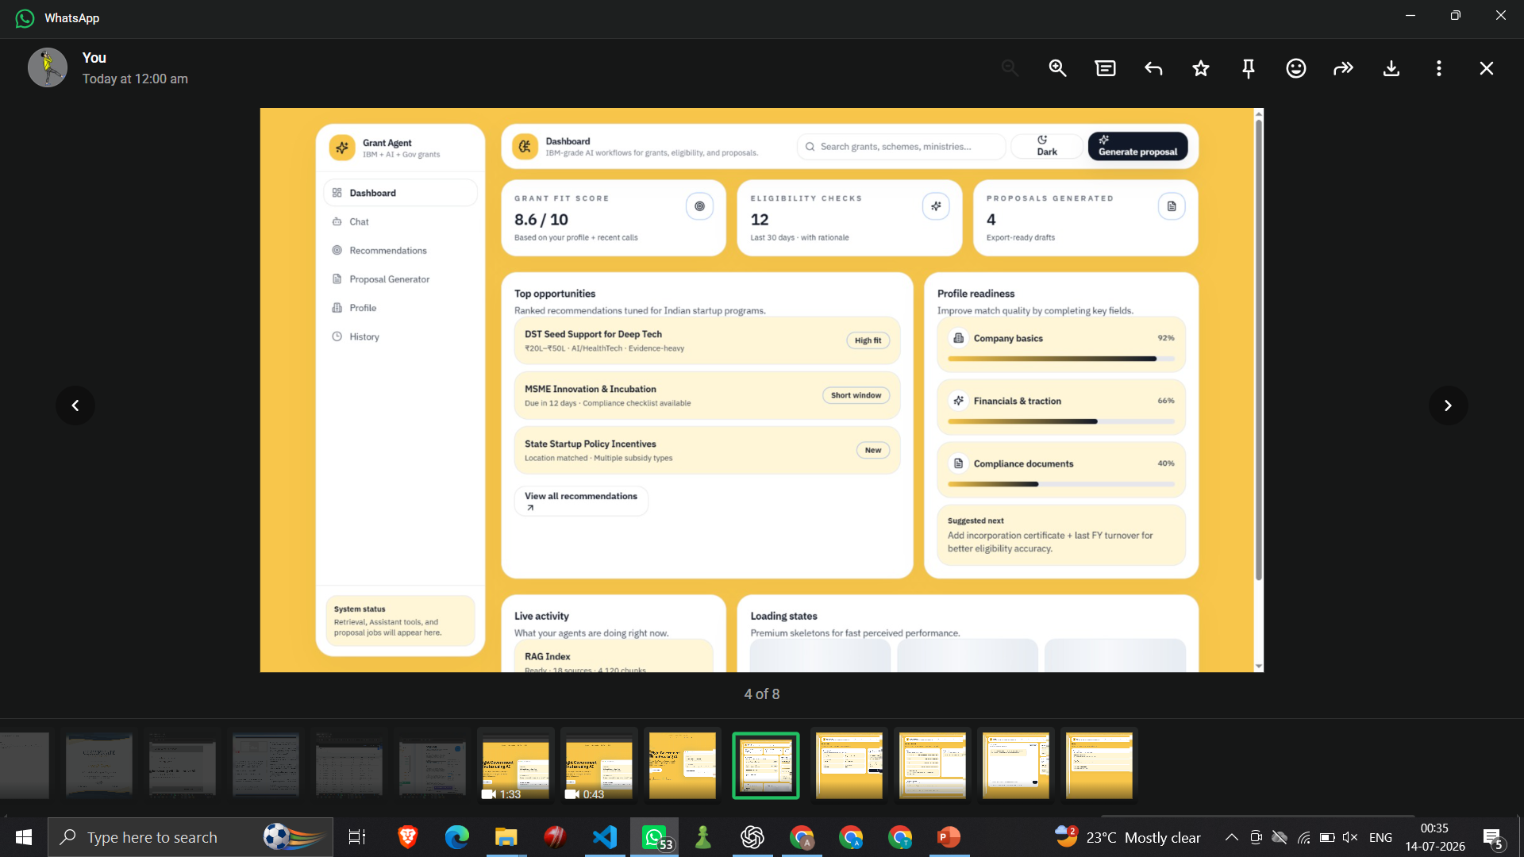
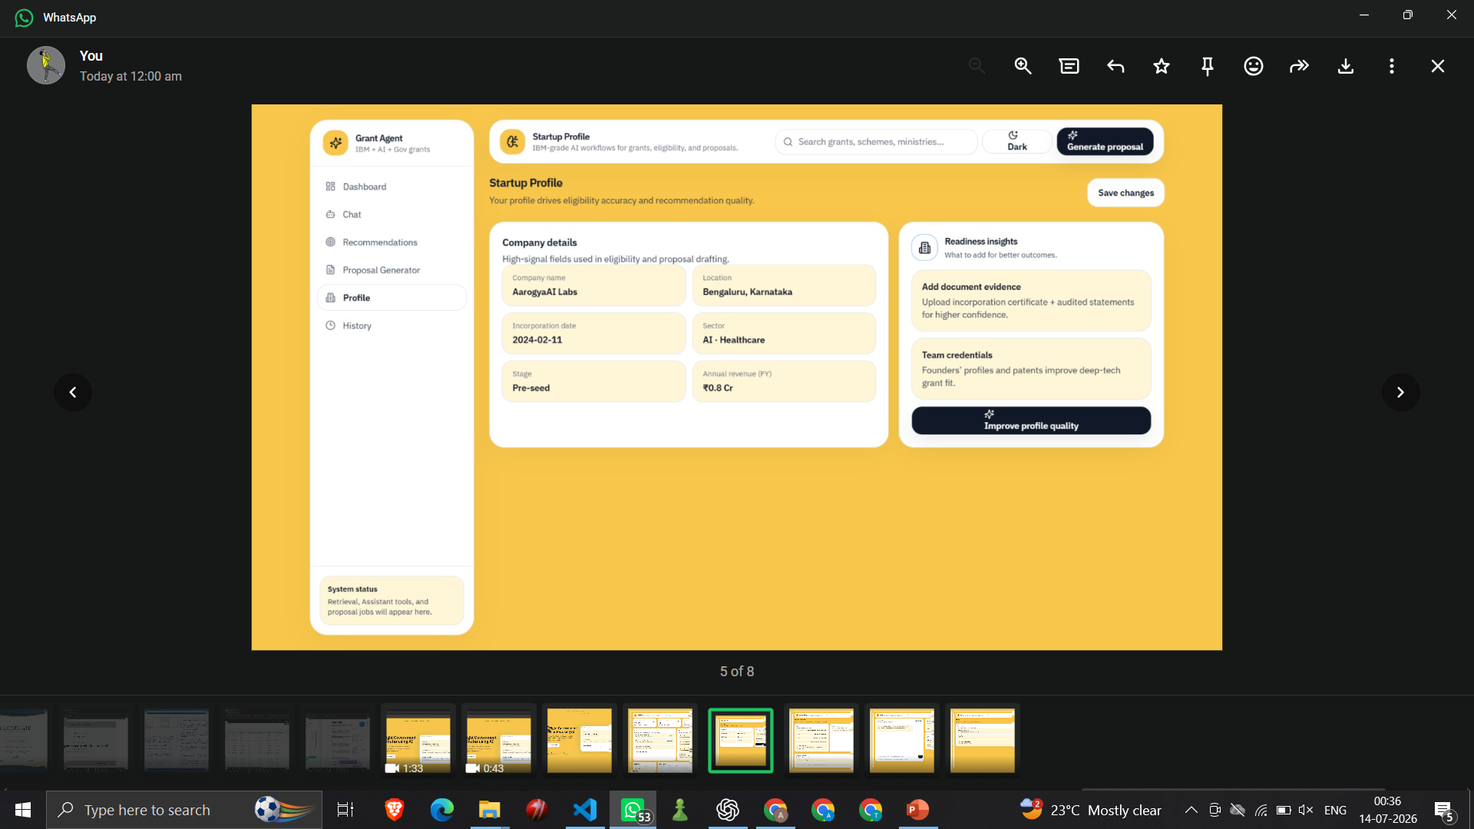
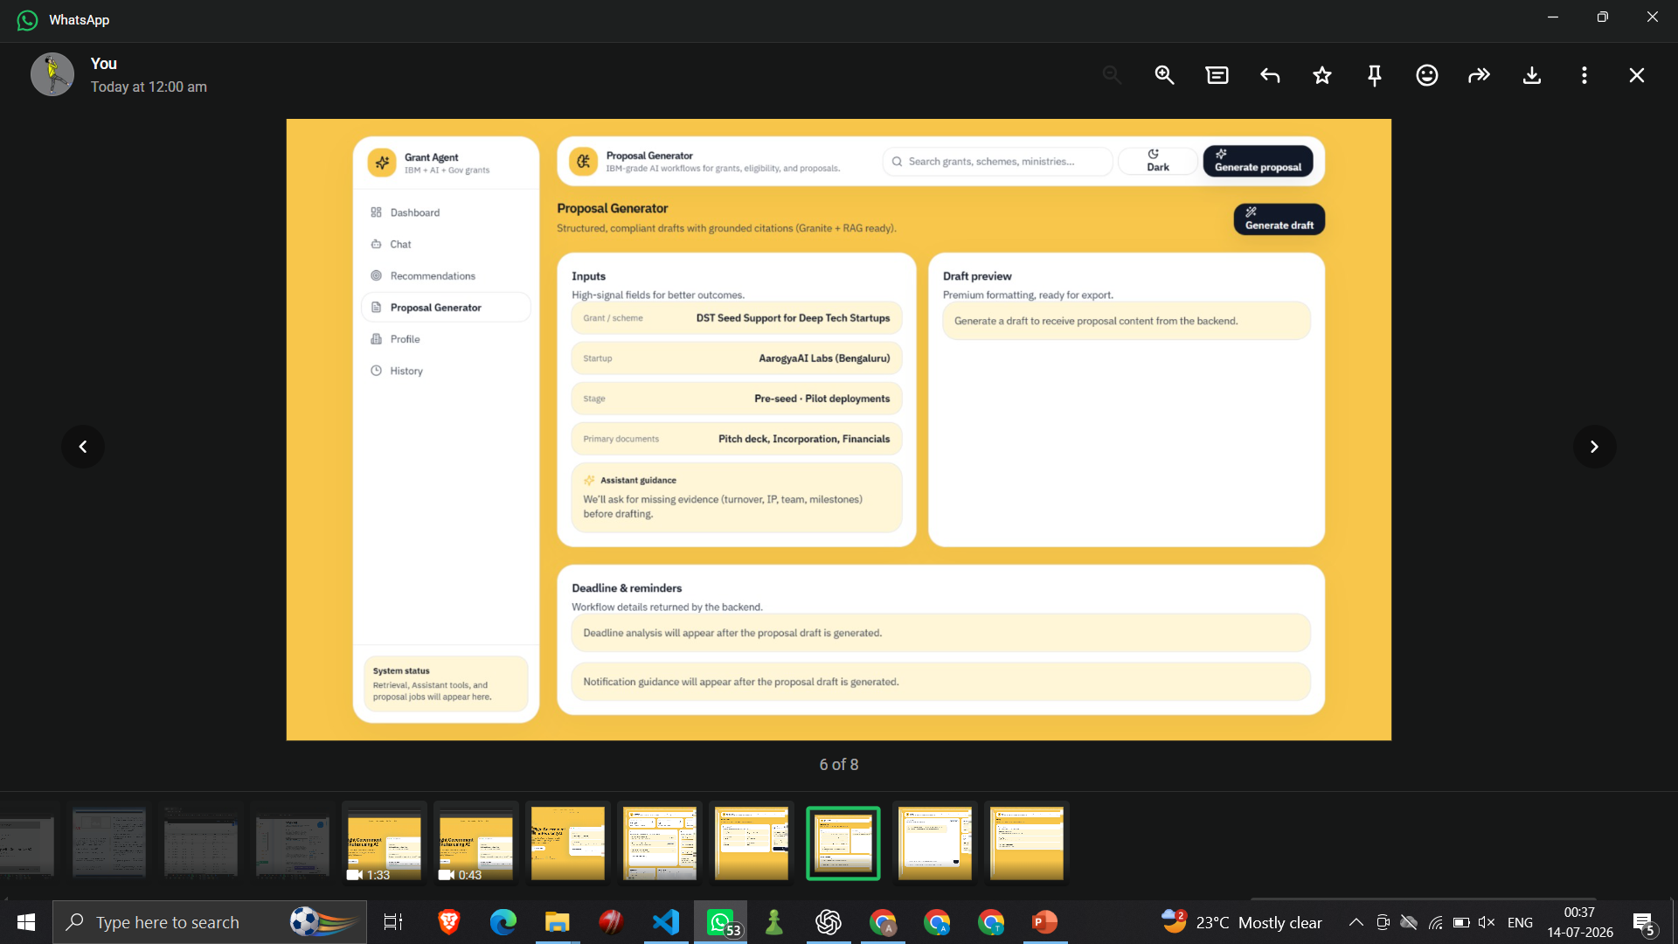
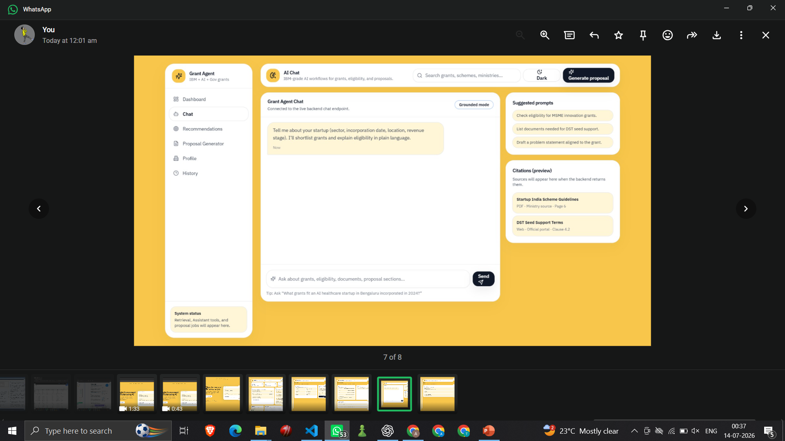
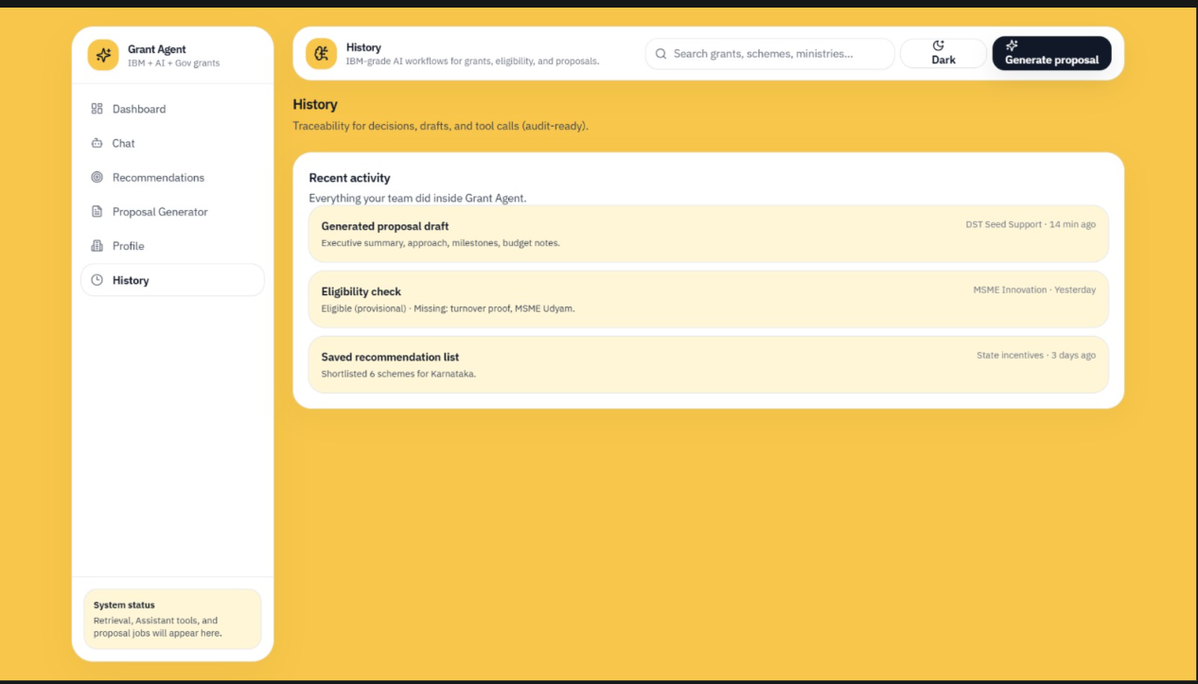
Application Screenshots:

Slide 8
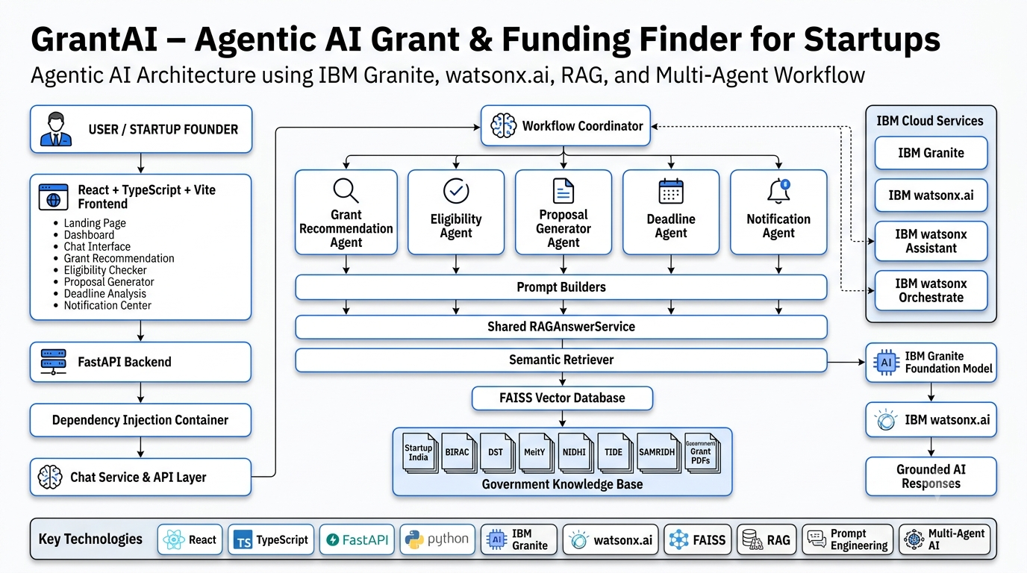
System Architecture

Slide 9

Role of Agentic AI in the solution
Role of Agentic AI in GrantAI
Agentic AI enables GrantAI to operate as a coordinated funding guidance system rather than a simple grant-search chatbot.
Using IBM Granite and a multi-agent workflow, GrantAI decomposes a founder's funding journey into specialized tasks and coordinates dedicated AI capabilities.
The Grant Recommendation Agent identifies relevant schemes, the Eligibility Agent evaluates available startup information against grant evidence, the Proposal Generation Agent prepares grounded application content, the Deadline Agent analyses supported timing information, and the Notification Agent recommends practical next actions.
A WorkflowCoordinator manages the execution sequence and passes relevant context between capabilities. This allows a single founder request to trigger multiple grant-related tasks while preserving service boundaries.
Agentic AI also provides context-aware execution. Startup details such as sector, development stage, location, funding requirement, and project objectives influence the analysis.
The system follows a best-effort workflow. If one stage encounters an error, remaining stages can continue where possible and partial results can still be returned.
Overall, Agentic AI transforms GrantAI from a static grant finder into a goal-driven, evidence-grounded startup funding assistant that supports the journey from grant discovery to application preparation.

Slide 10
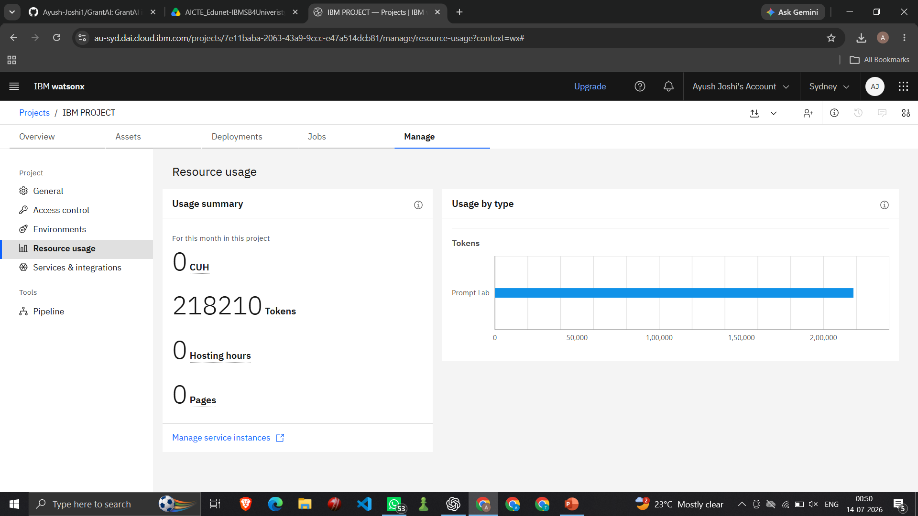
Token Usage
Total Tokens Used: 2,18,210
·
·
·

Slide 11
Novelty and Uniqueness
GrantAI stands out by combining Agentic AI, Retrieval-Augmented Generation, specialized prompt engineering, and end-to-end grant workflow coordination in a single startup funding platform.
Multi-Agent Grant Intelligence – Five specialized AI capabilities collaborate across recommendation, eligibility, proposal generation, deadline analysis, and notification guidance.
RAG-Based Grounding – Grant information is retrieved from an indexed government grant knowledge base before IBM Granite generates a response.
Startup-Aware Personalization – Recommendations and analysis consider startup sector, development stage, location, funding requirement, and project context.
Evidence-Aware Eligibility Analysis – The system distinguishes supported eligibility matches from missing or unconfirmed information instead of automatically declaring a startup eligible.
Safe Deadline Analysis – GrantAI explicitly prevents invented deadlines, unsupported days-remaining calculations, and false claims that applications are currently open.
Grounded Proposal Assistance – Proposal drafts use supplied startup facts and retrieved grant evidence while avoiding fabricated achievements, partnerships, revenue, or approvals.
Unified Grant Journey – A single founder request can trigger multiple specialized capabilities and return one structured funding guidance response.
Source Transparency – Retrieval-derived source metadata is preserved to improve traceability and trust.
This makes GrantAI more than a grant search engine or generic chatbot—it is an evidence-grounded Agentic AI platform for startup funding discovery and application preparation.

Slide 12
GitHub Repository
· Github URL – https://github.com/Ayush-Joshi1/GrantAI
·
·
·

Slide 13
Future Scope
1. Real-Time Government Grant Aggregation
GrantAI can be extended with authorized data ingestion pipelines to periodically collect and update grant information from official government portals. This would allow the knowledge base to reflect new schemes, updated guidelines, and application-window changes more efficiently.
2. Automated Application Readiness Workspace
A startup-specific workspace can track required documents, eligibility gaps, proposal completion, budget preparation, and verified deadlines for selected grants.
3. Multilingual Grant Assistance
IBM Granite-powered multilingual interaction can improve access for startup founders who prefer regional Indian languages when understanding complex grant guidelines.
4. Human-in-the-Loop Proposal Review
Future versions can include mentor, incubator, or funding-expert review workflows before final application submission, preserving human validation for critical grant content.
5. Advanced Grant Matching and Feedback Learning
GrantAI can improve recommendation ranking using founder feedback, saved grants, application outcomes, and scheme relevance signals.
6. Secure Enterprise and Incubator Deployment
The platform can be extended for startup incubators, universities, accelerators, and entrepreneurship cells to support multiple startups through a governed funding discovery workflow.
·
·
·

Slide 14
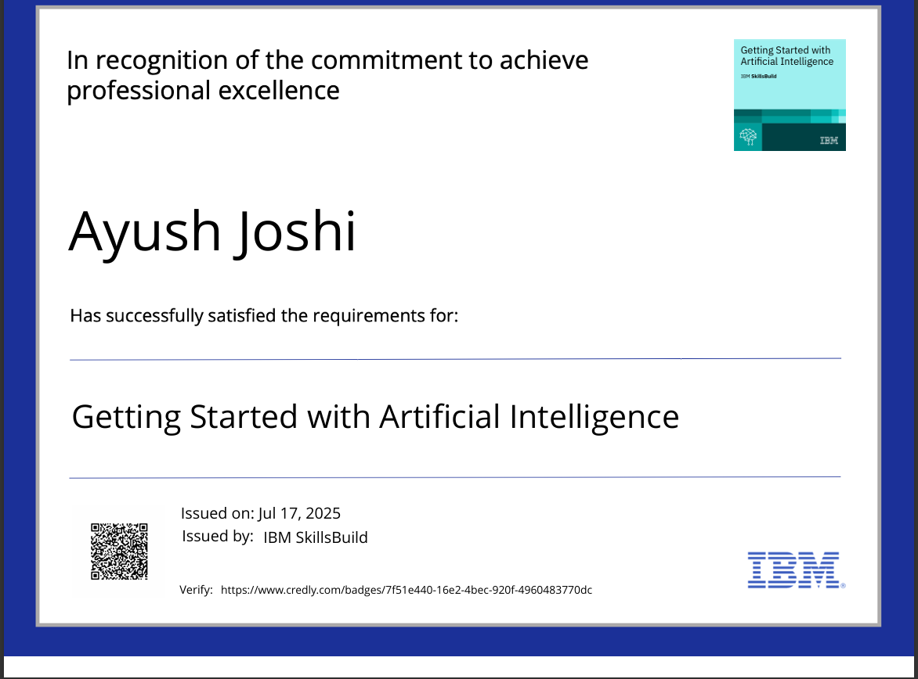
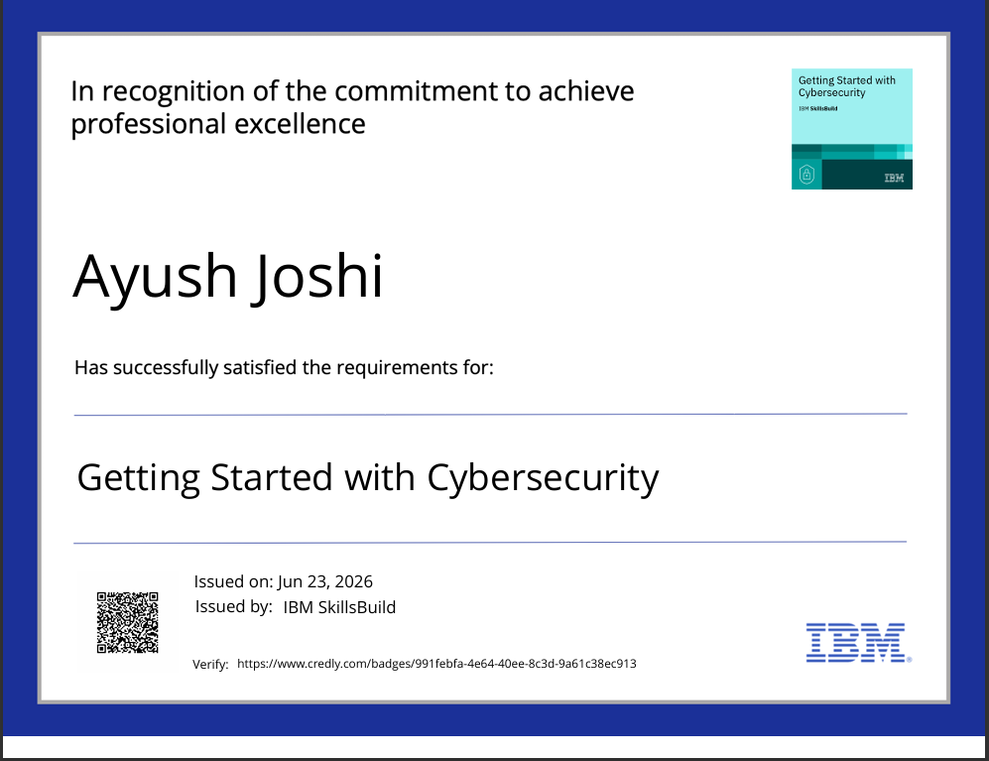
Certificates Earned:

Slide 15
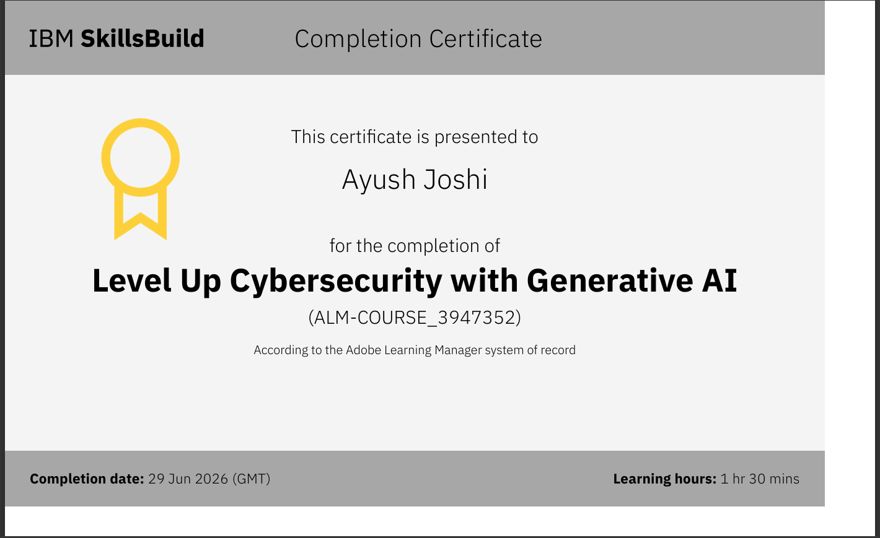
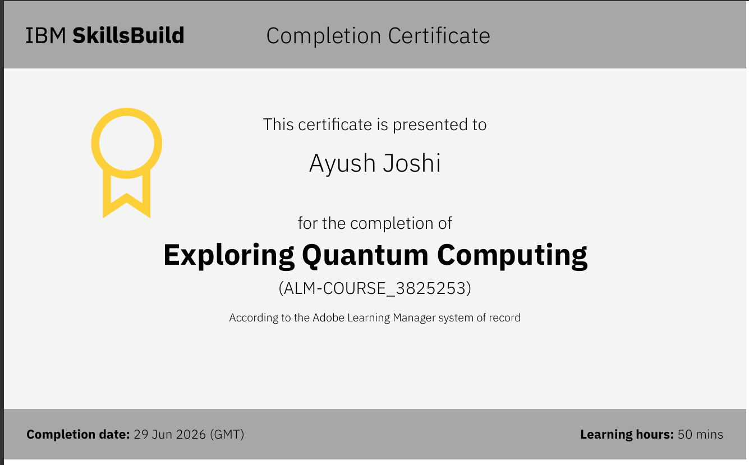
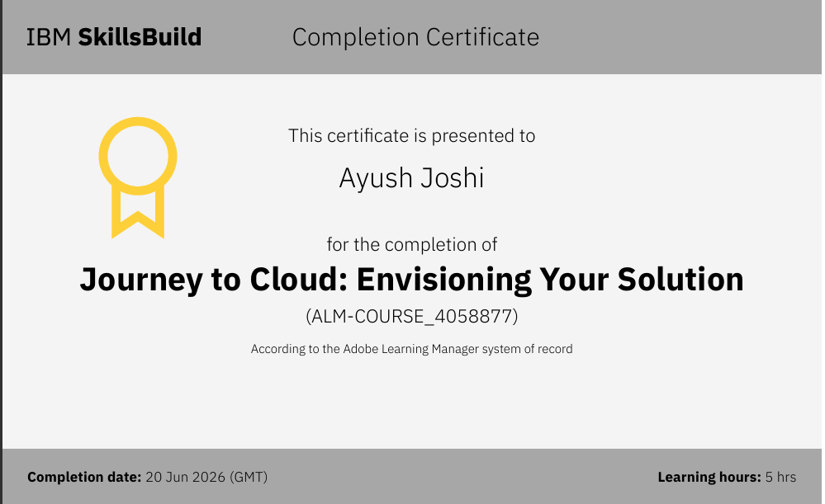
Certificates Earned:

Slide 16
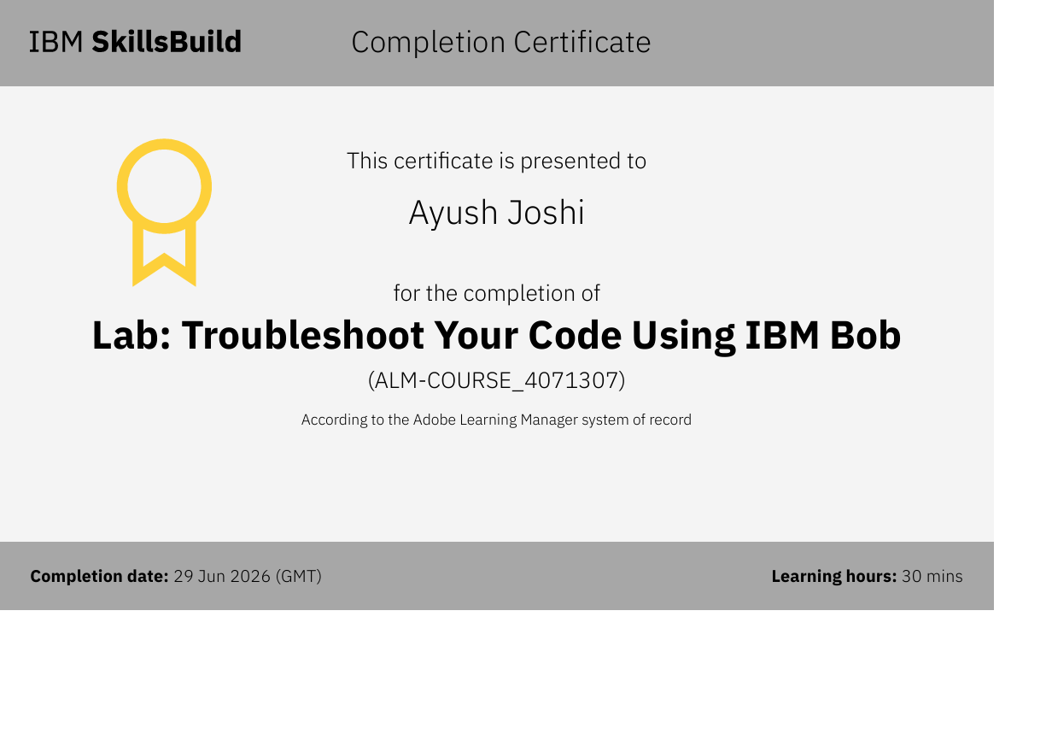
Certificates Earned:​
Add your IBM BOB Certificate

Slide 17
Thank You!

